Slide 1
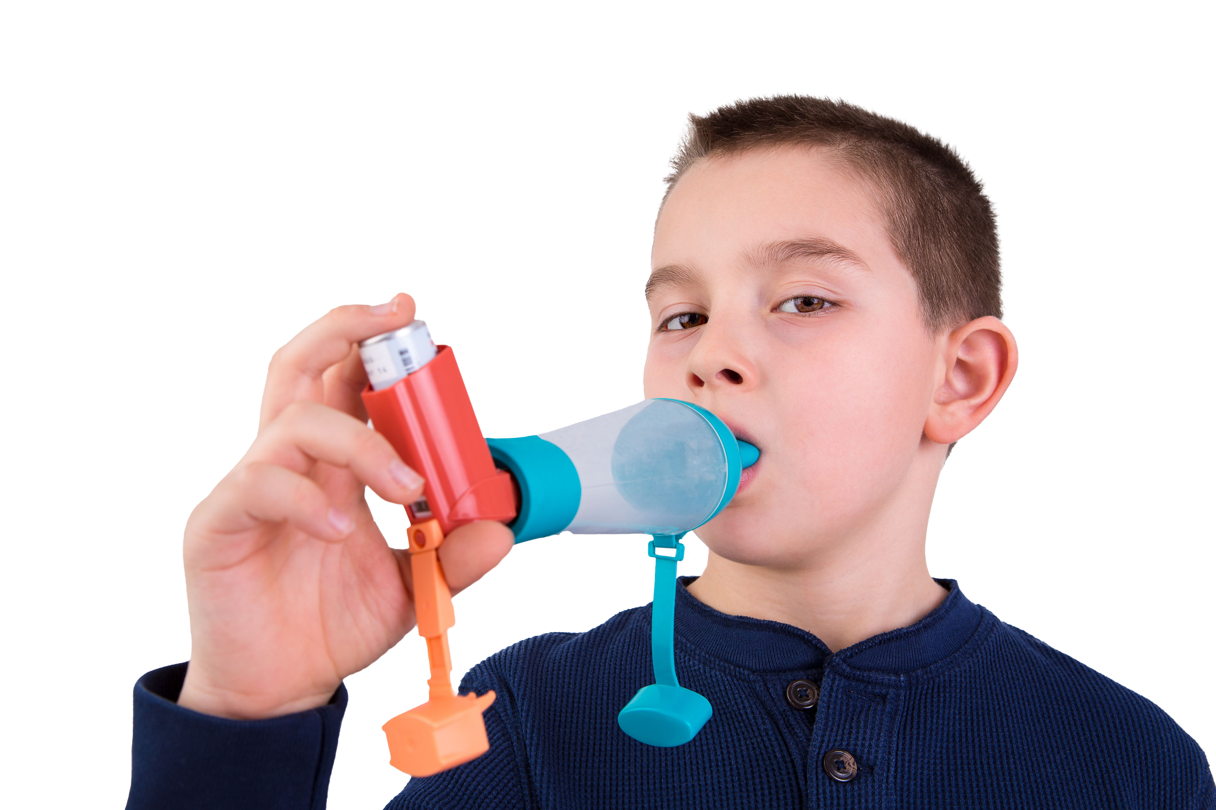
Why is asthma important?
Asthma is the most common long-term medical condition affecting children and young people
1 in 11 are affected by the condition, which is around 3 in every London classroom
Many have badly managed asthma, with over 20,000 admitted to hospital every year in England. Over 4% of these have such a severe episode that they are admitted to intensive care
Children die in London every year because of asthma. 90% of asthma deaths are preventable: these children should have gone on to lead full and productive lives.
#AskAboutAsthma 2024: Fact sheet for local authorities
London’s annual #AskAboutAsthma campaign raises awareness of 4 simple asks that can make a big difference to how children and young people experience their asthma – having an asthma plan, attending a regular asthma review, using inhalers properly and knowing how air pollution affects them.
This campaign has been running for 8 years, led by NHS England – London’s babies, children and young people’s transformation team. This year’s campaign takes place from 9-15 September 2024.
The theme for 2024 is ‘Helping children and young people with asthma to live their best lives’.
Local authorities can help children and young people with asthma live their best lives: your schools, community organisations, Public Health, Housing and Air Quality teams can all play a role in raising awareness about asthma, and the health impacts of indoor and outdoor air pollution.
Support the campaign and share it with your borough’s residents and communities:
Your communications team can share the campaign and information about asthma on your public facing website, through resident newsletters, housing associations and social media. Resources and messaging can be found here .
Share this fact sheet with staff and service leads so they can signpost families to information about asthma care and practical ways to reduce the risk of triggers at home, at school and in the community.
Work with your local NHS, housing, education and air quality teams to develop longer term strategies that consider health inequalities and air pollution to improve children and young people’s asthma care. This could mean:
Connecting with your schools by sharing campaign information in your boroughs’ school newsletters
Are your schools asthma friendly? Good asthma management will reduce school absences and help pupils to take part in activities to support their overall health and wellbeing, as well as cutting risk of childhood obesity.
Sharing clear and accessible messages about the risks of vaping for under-18s – see suggested messaging here.
Discussing the respiratory health implications of damp and mould and resources available with housing colleagues.
Encouraging borough-wide initiatives to improve air quality: e.g. no idling outside schools or parks, and active travel.
Did you know…?
Asthma is the most common chronic medical reason for students missing school. Absenteeism due to illness represents a barrier to achievement and standards.
Key messages
Asthma should not limit children and young people’s lives in any way.
Good asthma control means having NO symptoms.
Following the 4 asks means children and young people can live their best lives.
Follow us on social media to stay up to date:
X: bcyp_nhsldn
Instagram: bcyp_nhsldn
And contact us for more info

