Slide 1
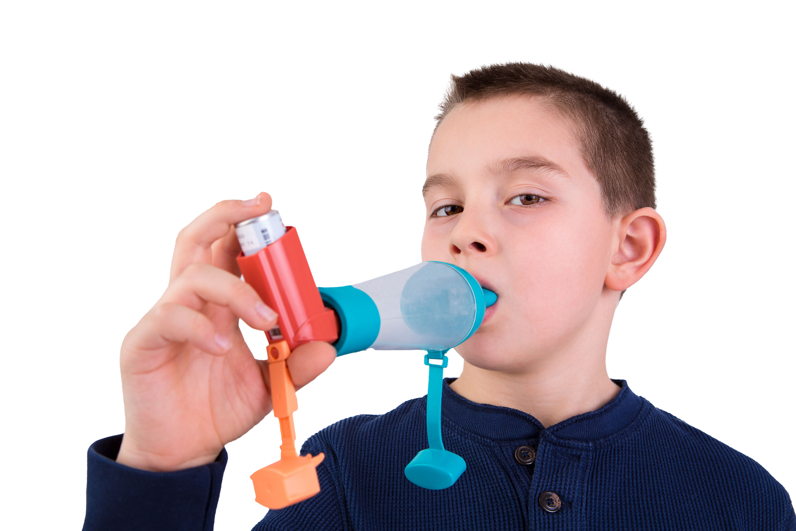
Asthma is the most common long-term medical condition affecting children and young people
1 in 11 are affected by the condition, which is around 3 in every London classroom
Many have badly managed asthma, with over 20,000 admitted to hospital every year in England. Over 4% of these have such a severe episode that they are admitted to intensive care
Children die in London every year because of asthma. 90% of asthma deaths are preventable: these children should have gone on to lead full and productive lives.
#AskAboutAsthma 2024: fact sheet for pharmacy
London’s annual #AskAboutAsthma campaign raises awareness of 4 simple asks that can make a big difference to how children and young people experience their asthma – having an asthma plan, attending a regular asthma review, using inhalers properly and knowing how air pollution affects them.
This campaign has been running for 8 years, led by NHS England – London’s babies, children and young people’s transformation team. This year’s campaign takes place from 9-15 September 2024.
This year’s theme is Helping children and young people with asthma to live their best lives. See the campaign webpage to find out more.
How pharmacists can support the #AskAboutAsthma campaign:
Improving your knowledge of children and young people’s asthma by attending the conference and webinars, and accessing our blogs, videos and podcasts – then sharing what you learn. Pharmacy day is Tuesday 10th Sept and the webinar starts at 7.30pm.
Offering all children and young people with asthma an inhaler technique check.
Identifying which children and young people are not regularly collecting their preventer medication and communicating this to their GP practice.
Identifying which children and young people are collecting large numbers of reliever medication and communicating this to the GP practice.
Informing patients trying to buy a nebuliser or nebules to deliver asthma rescue medication to children and young people that these should only be used if recommended and managed by an asthma specialist.
Displaying the #AskAboutAsthma campaign poster in pharmacy waiting areas or notice boards to encourage children, young people and their parents or carers to speak to their pharmacist, GP or nurse if they need help managing their asthma.
Ensuring that parents understand that if a child or young person’s asthma is well controlled, that they will be less likely to miss school, have an asthma attack and will have a better quality of life.
Sharing messaging with your asthma patients and their parents/carers around asthma triggers including smoking, vaping and damp and mould and why it’s important to minimise exposure where practical and possible
Did you know…?
Nearly half of children admitted to hospital have had an asthma attack in the previous year and 30% have had daytime symptoms in the previous week. But only a fraction have a personalised asthma action plan.
Contact us
For more information, contact the #AskAboutAsthma team on: england.cyptransformationldn@nhs.net
Follow us on social media to stay up to date on the campaign:
X: bcyp_nhsldn
Instagram: bcyp_nhsldn

