Slide 1
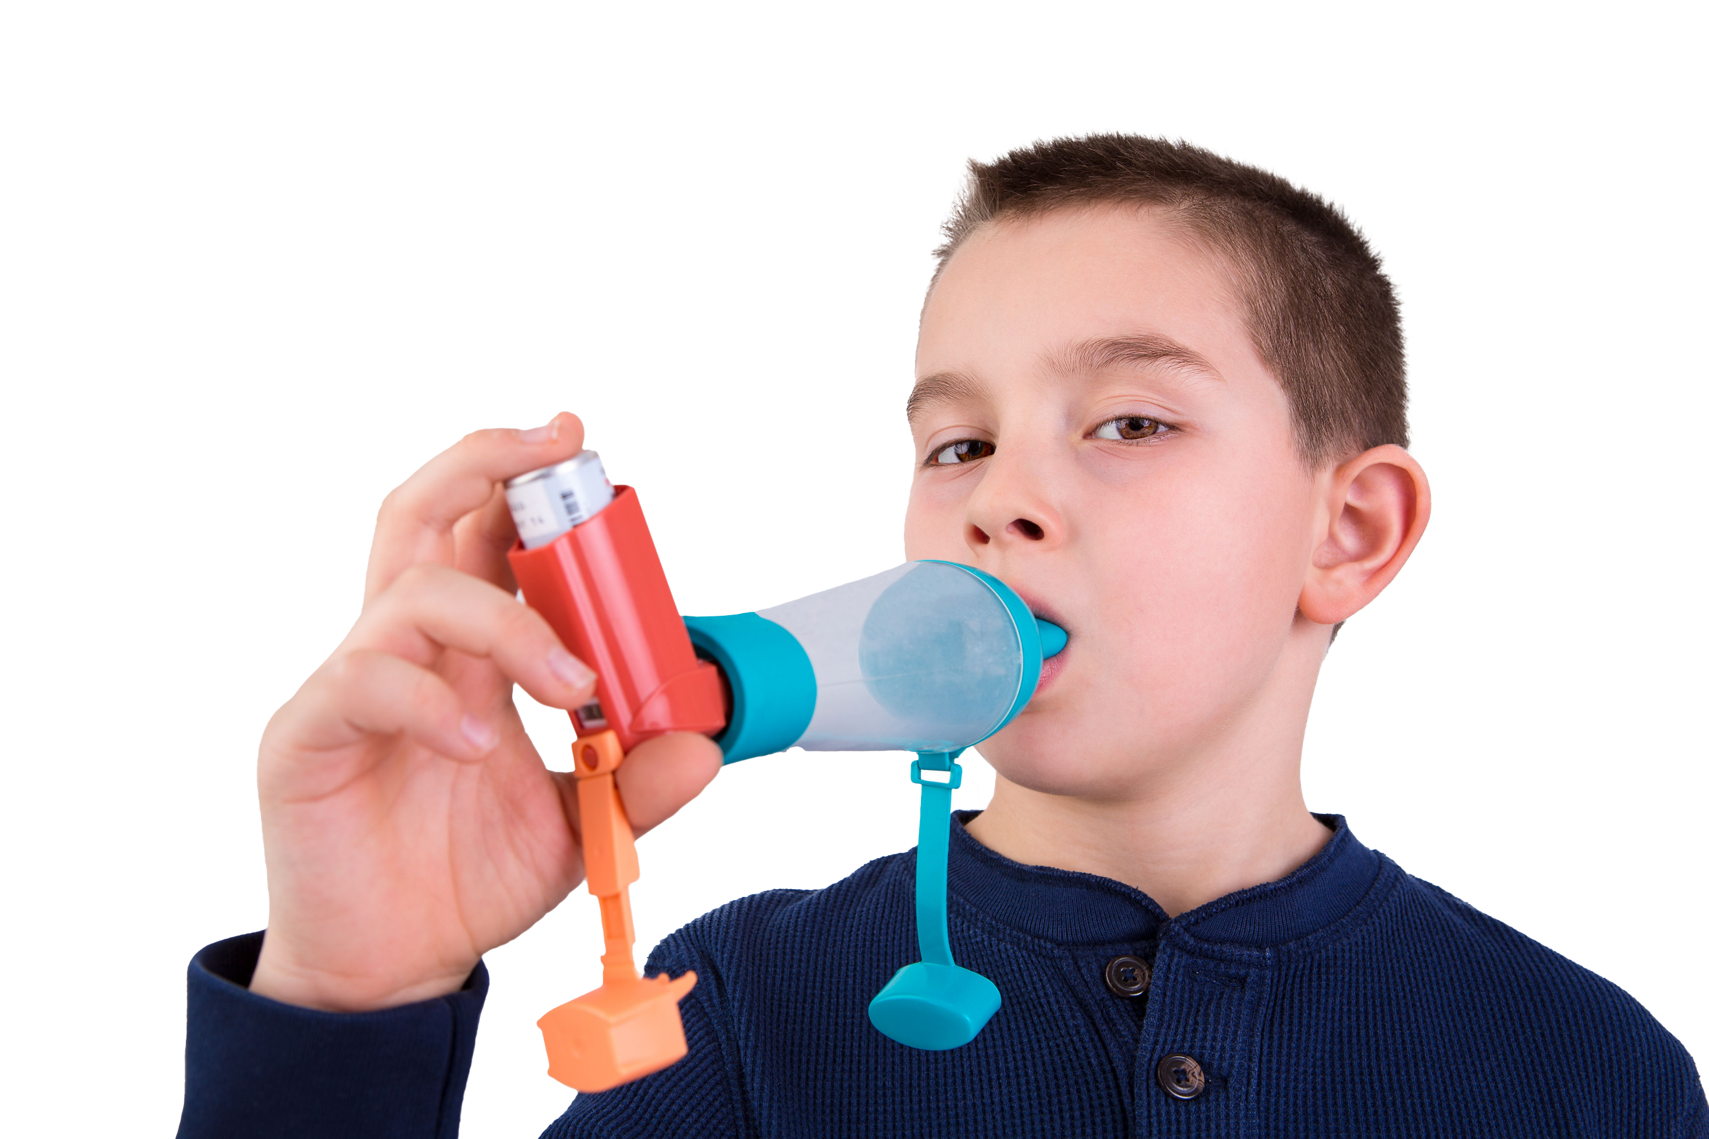
Asthma is the most common long-term medical condition affecting children and young people
1 in 11 are affected by the condition, which is around 3 in every London classroom
Many have badly managed asthma, with over 20,000 admitted to hospital every year in England. Over 4% of these have such a severe episode that they are admitted to intensive care
Children die in London every year because of asthma. 90% of asthma deaths are preventable: these children should have gone on to lead full and productive lives.
#AskAboutAsthma 2024: fact sheet for ICBs
London’s annual #AskAboutAsthma campaign raises awareness of 4 simple asks that can make a big difference to how children and young people experience their asthma – having an asthma plan, attending a regular asthma review, using inhalers properly and knowing how air pollution affects them. Good asthma control means no symptoms – asthma shouldn't limit children and young people’s lives in any way.
This campaign has been running for 8 years, led by NHS England – London’s babies, children and young people’s transformation team. This year’s campaign takes place from 9-15 September 2024.
See the campaign webpage to find out more.
How ICBs can support the #AskAboutAsthma campaign:
Work with your communications team to share the campaign and information about asthma care on your public facing website, through newsletters and on social media: they can download the 2024 campaign toolkit for resources and messaging.
Display the #AskAboutAsthma campaign poster and digital background for waiting room screens to encourage children, young people and their parents/carers to speak to their GP, nurse or pharmacist if they need help managing their asthma.
Use our resources in the campaign toolkit and in our London Asthma toolkit to develop your own ICB #AskAboutAsthma campaign. You can send regular emails to staff within CYP asthma networks highlighting the campaign resources and local initiatives; develop blogs with local stakeholders; run asthma training sessions within local primary and secondary care settings, etc.
Develop your ICB intranet page highlighting local events and activities as well as examples of good practice or innovations.
Your commissioners and programme leads can:
Capture data and case studies on asthma to inform your planning of whole system CYP asthma programmes.
Actively plan CYP asthma projects and campaigns alongside local environmental health teams to address the impact of air pollution (both indoor and outdoor) on asthma sufferers, and consider how to improve children, young people and families’ awareness that smoking, vaping and mould in homes can trigger asthma and other respiratory conditions. Share information about the London Damp and Mould Checklist.
Consider how health inequalities are worsening the effects of asthma among your children and young people.
Did you know…?
Asthma is the most common chronic medical reason for students missing school. Absenteeism due to illness represents a barrier to achievement and standards.
Contact us
For more information contact the #AskAboutAsthma team on: england.cyptransformationldn@nhs.net
Follow us on social media to stay up to date on the campaign:
X: bcyp_nhsldn
Instagram: bcyp_nhsldn

