Slide 1
“ Learning Together” A Celebration of Mental Health

Slide 2
Our approach
n
h
a
d
s
c
p
a
e
o
c
r
i
p
p
a
l
a
i
s
d
t
e
e
t
x
a
p
Building on over 25 years’ experience of working with schools and local communities.
r
e
g
r
e
t
t
Supporting
i
n
children and
s
I
e
young people
Place2Be is a children's mental health charity providing school- based support and in-depth training programmes to improve the emotional wellbeing of pupils, families, teachers and school staff.
Supporting carers and parents
Supporting school staff
School leadership and governance

Slide 3
Our achievements
Last year…
We provided an embedded mental health service in almost 400 UK primary and secondary schools, supporting a school community of around 225,000 children and young people.
27,995 children and young people booked their own Place2Talk session to speak to Place2Be. 5,875 pupils accessed one-to-one weekly support.
Over 54,000 UK teachers and school staff accessed our online training programme.
Our resources for schools and families were viewed or downloaded over 124,000 times.

Slide 4
Place2Be’s Positive Practice and impact on mental health
“I feel 11 out of 10 now. Place2Be has helped me come out of my shell.”
12-year-old boy
After children and young people access our weekly, one-to-one support:
79% of those with severe difficulties show an improvement in mental health*
Our follow-up study found that children and young people continue to benefit from these improvements one year later. 88%** of pupils maintained no/moderate difficulties one year after counselling.
*Place2Be Parent SDQ, August 2020 - July 2021
**2019/20 Academic Year

Slide 5
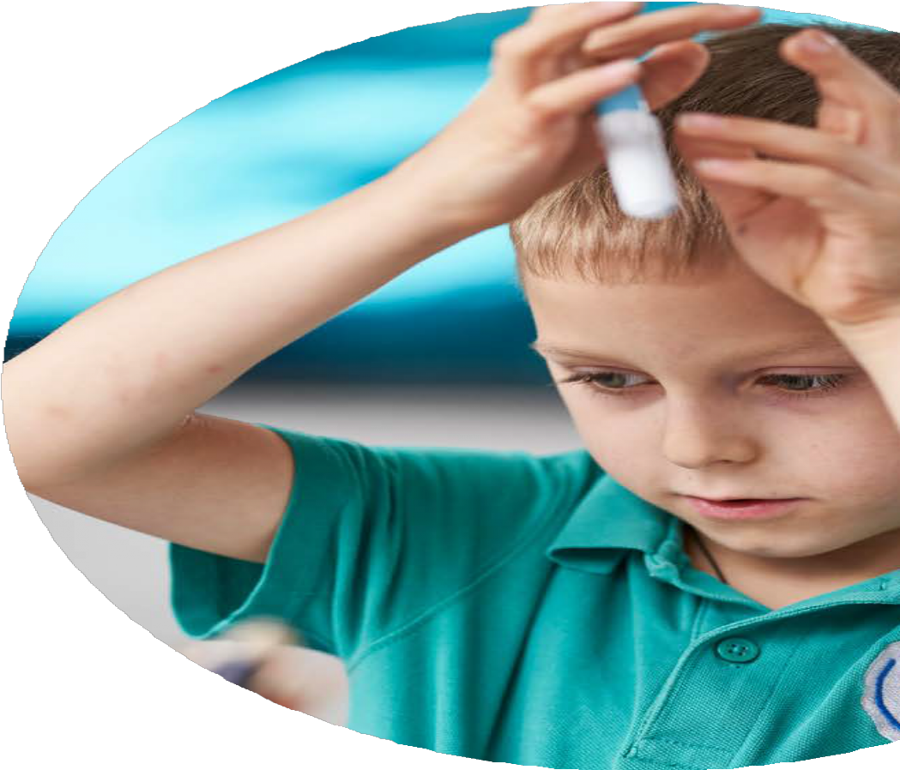
Sharing Learning Issues that children and young people bring to Place2Be
Primary
100
80
75%
72%
60
69%
65%
65%
40
20
General anxiety
Attention difficulties
Low self esteem
Social anxiety
Ongoing family
tensions
14% experience self-destructive thoughts or acts and 7% experience suicidal thoughts. 17% experience eating difficulties.
*2020/21 Academic Year

Slide 6
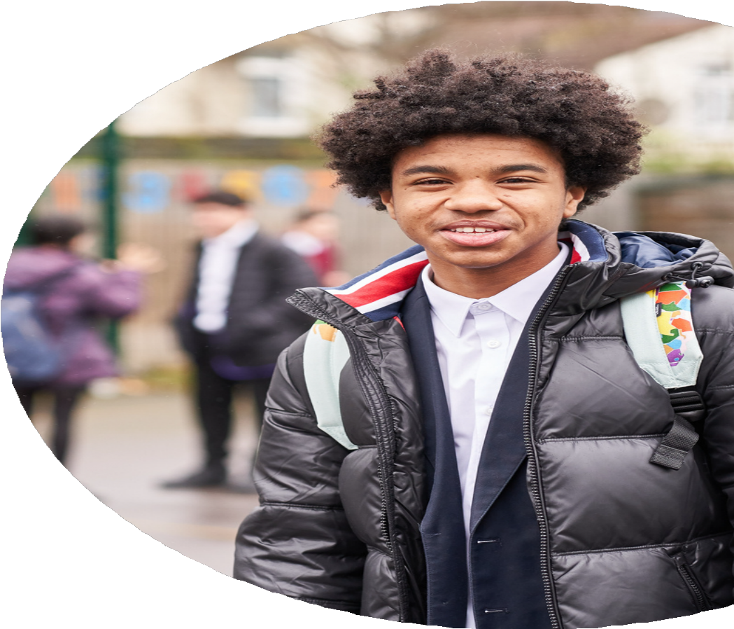
Sharing Learning Issues that children and young people bring to Place2Be
Secondary
100
80
85%
80%
75%
73%
60
67%
40
20
General Anxiety
Low self esteem
Depression
Social anxiety
Mood swings
39% experience self-destructive thoughts or acts, and 22% have experienced suicidal thoughts. 21% experience eating difficulties.
*2020/21 Academic Year

Slide 7
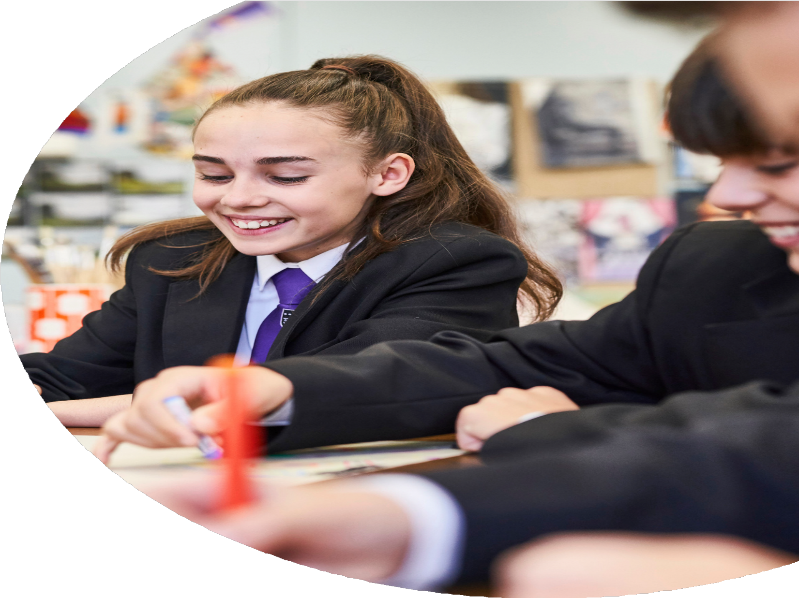
Ongoing development and improvement Building awareness and skills in schools
In August 2020, we launched our online Mental Health Champions – Foundation programme for UK teachers and school staff.
The programme aims to enhance professionals’ understanding of children’s mental health and introduces approaches that foster positive wellbeing in schools and communities.
Last year, over 54,000 teachers and other professionals accessed the programme.
91% feel that the course has increased their capacity to lead a positive approach to mental health and wellbeing*.
*October 2021; 27,546 participants surveyed
Notes:
Mention Senior Mental Health programme -

Slide 8
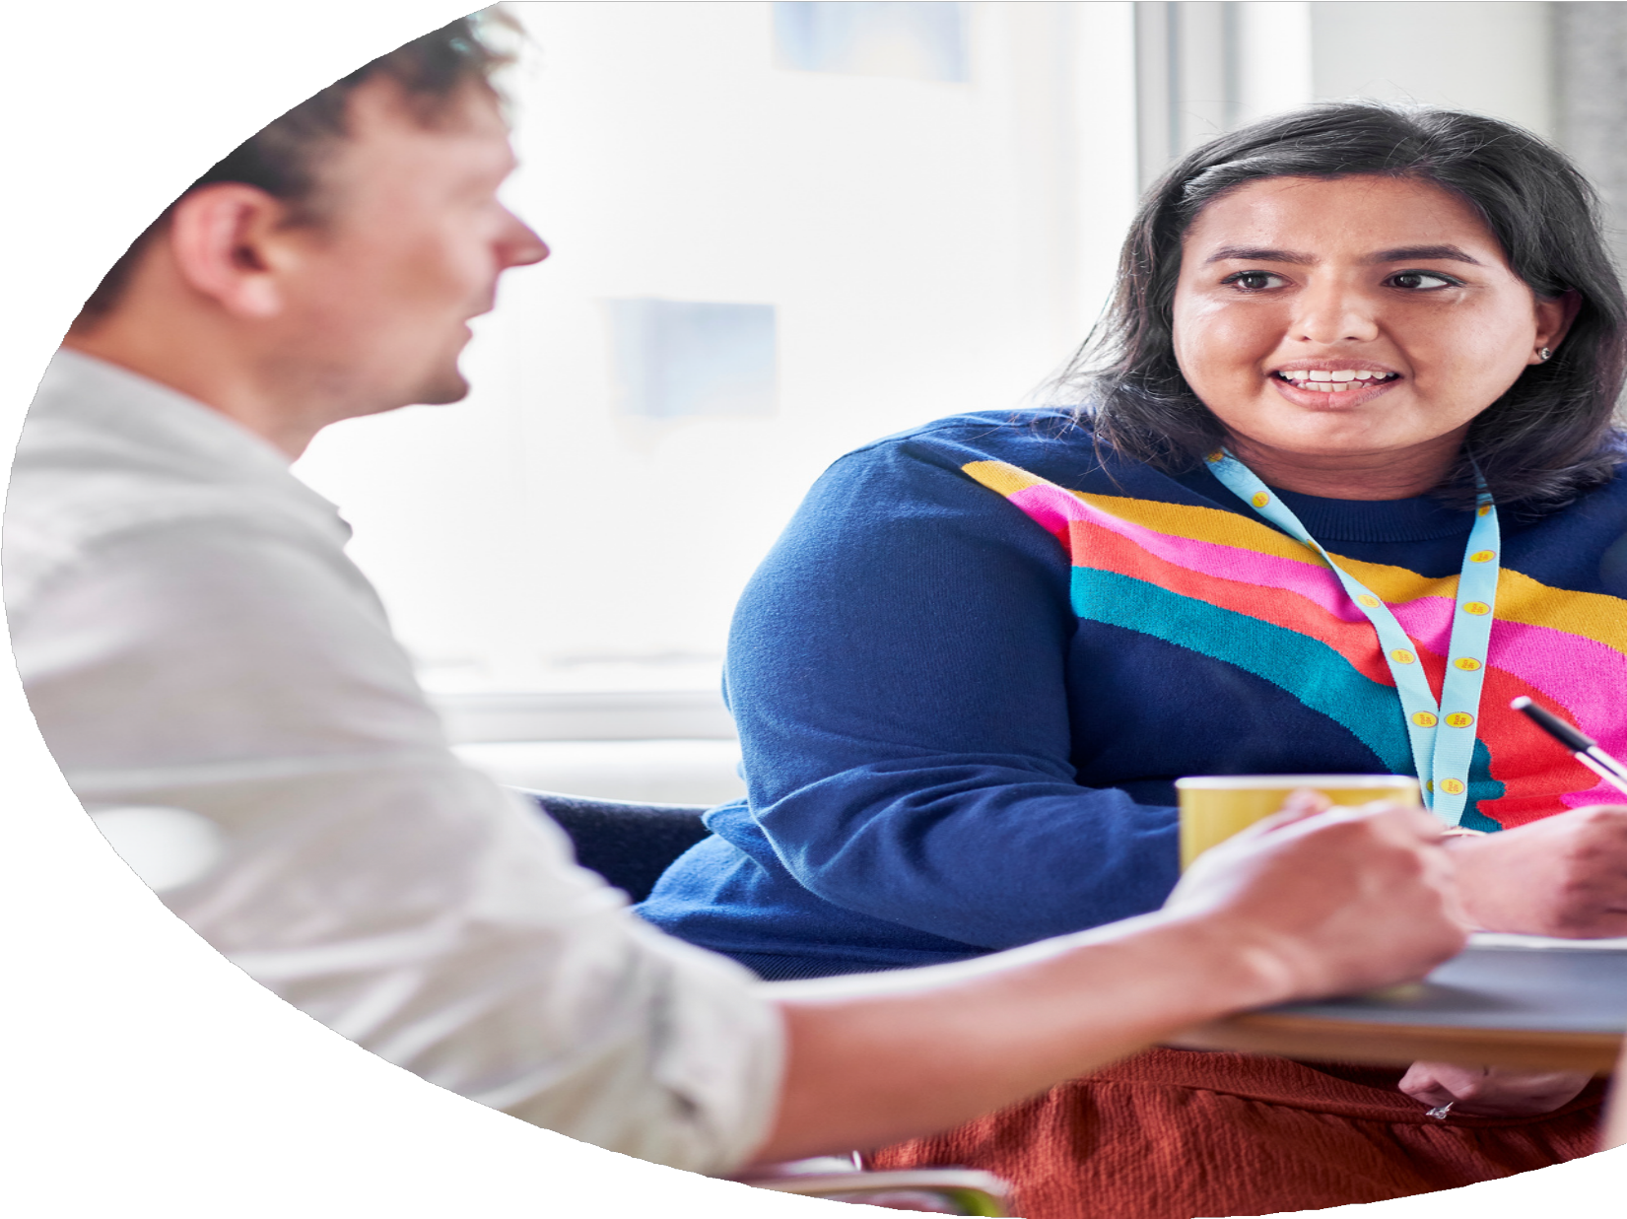
Our support for families
Focuses on:
Improving outcomes for children and families with an emphasis on early intervention
Strengthening parental capacity and family relationships, especially in relation to managing challenging behaviour Increasing parental engagement in their local school community and in their children’s education and development
Practical advice and tips are available for free for all parents and carers of 4-11 year olds on our website – parentingsmart.org.uk
Parents and carers in our partner primary schools can access face-to-face and online support and training, via our dedicated Family Practitioners.

Slide 9
“At the start of my sessions I felt really angry all the time and I was losing my temper a lot both at home and at school. Now I am a lot calmer and
happier.”
Contact details:
Jacqueline Vaughan Regional Director
Email: Jacqueline.Vaughan@place2be.org.uk
Cecilia Corbetta
Regional Clinical Lead
Email: Cecilia.Corbetta@place2be.org.uk
7-year-old boy
“I think it helped me because now I understand what my feelings mean a bit more and I know it's okay to get upset.”
14-year-old girl
place2be.org.uk
@Place2Be
@Place2BeCharity

