Slide 1
Slipping through the net :
From “Basic Care”
To
Severe Asthma

Slide 2

Slipping through the net :
From “Basic Care”
To
Severe Asthma

Slide 3
The 2017 asthma deaths data
Notes:
To recap, this is the data for England and Wales for 2017 that drove the headlines. This is the recent trend – after three years of very similar data, we’ve seen an increase.

Slide 4
Person with asthma
Acute care
Primary care
Secondary care
Tertiary care
Community Pharmacists
Medicines

Slide 5
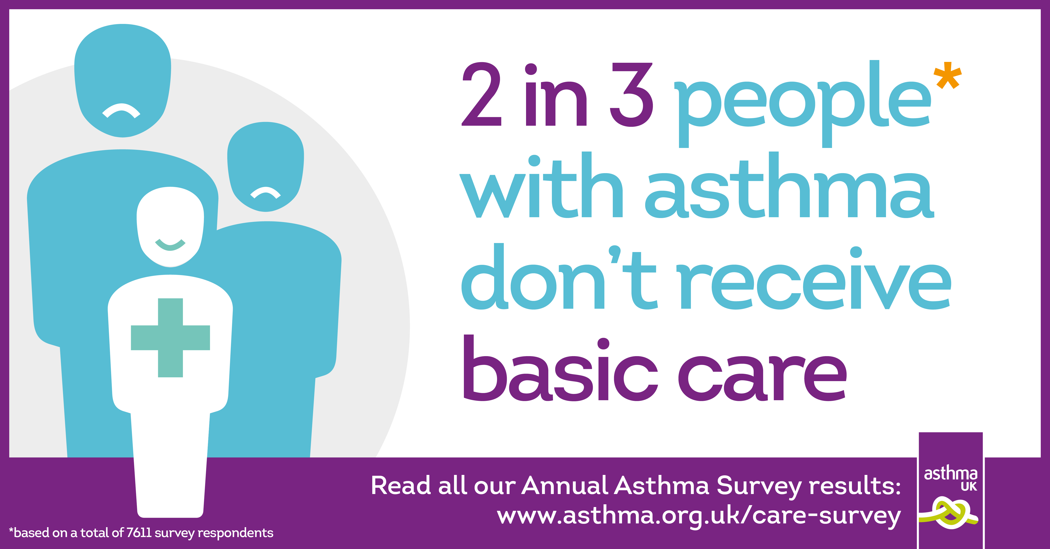

Slide 6
What is “Basic Care” ?
Annual review
Written asthma action plan
Inhaler technique check

Slide 7
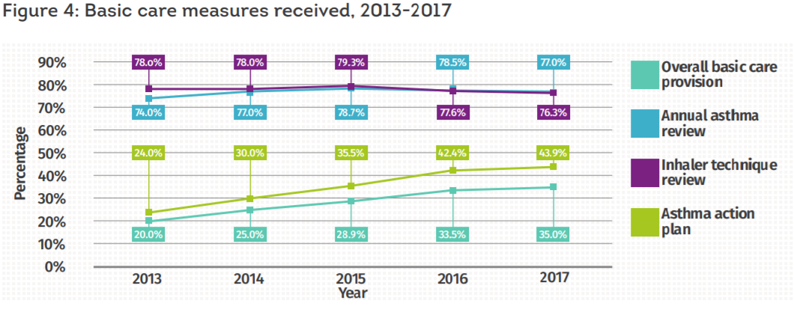
Asthma UK Annual Survey 2017

Slide 8
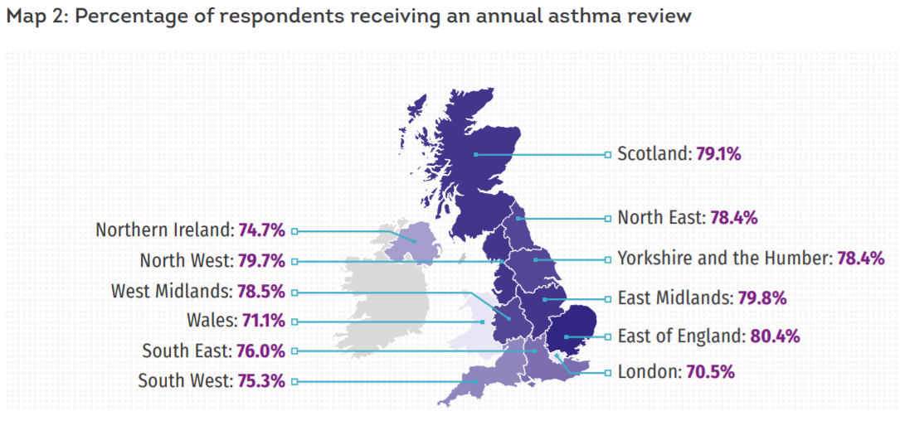

Receiving an annual review

Slide 9
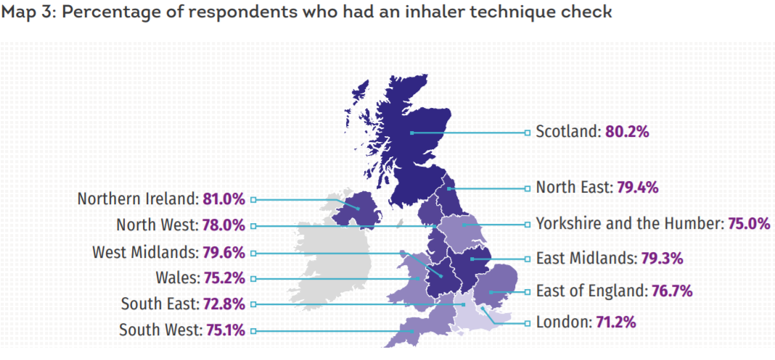
Having inhaler technique checked

Slide 10
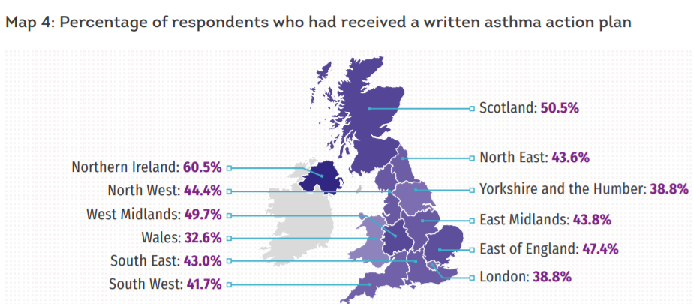
Written asthma action plans

Slide 11
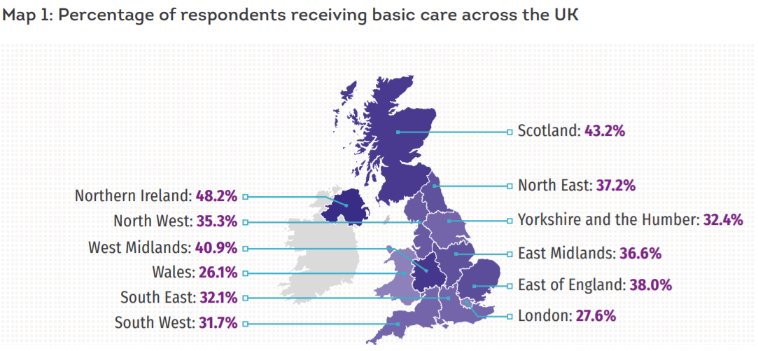
Getting the care they need
4

Slide 12
Getting the care they need
4
Almost ¾ of people with asthma in London are not getting “Basic Care”

Slide 13
Unpredictable triggers

Slide 14


Slide 15
Unpredictable triggers

Slide 16
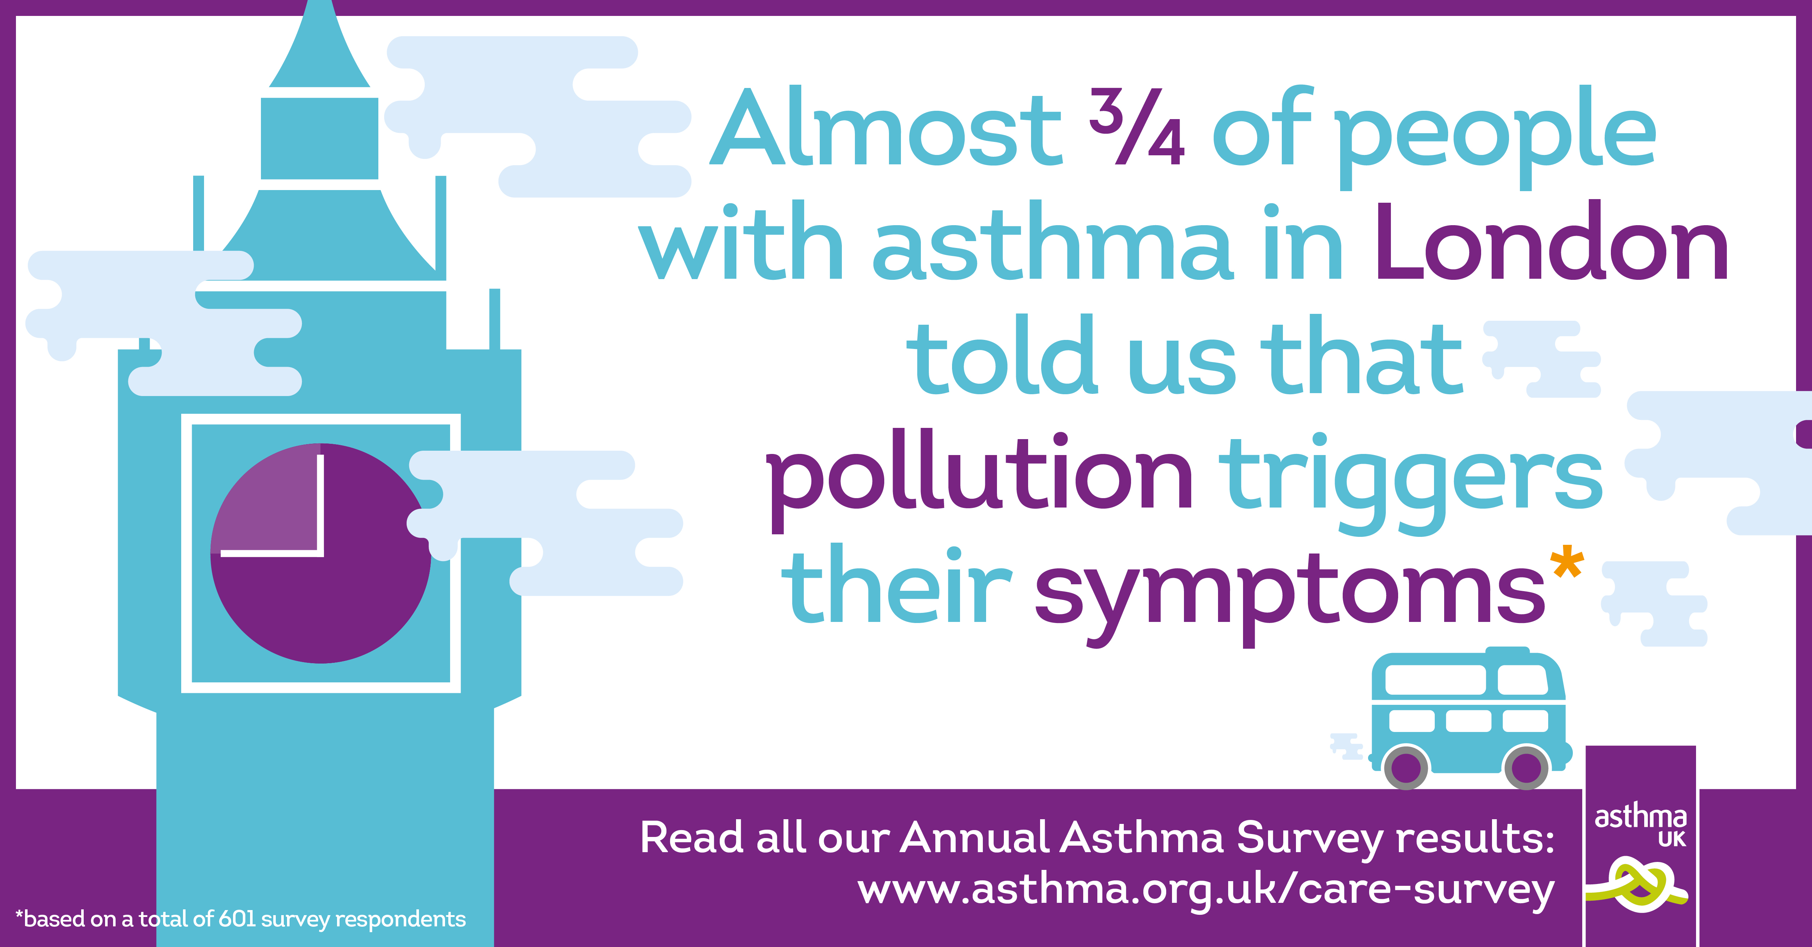

Slide 17
When can we make an impact?
No symptoms
Too many symptoms
Exacerbation
Symptoms
Admission
Specialist

Slide 18
When can we make an impact?
No symptoms
Too many symptoms
Exacerbation
Symptoms
Admission
Specialist
Optimise self care /seek help
Annual review
Inhalers
Action plans
Assess diagnosis, treatment and self care
Difficult vs Severe Asthma
Specialist treatments
Optimise self care
Assess diagnosis and treatment
Consider referral

Slide 19

Difficult and Severe Asthma

Slide 20
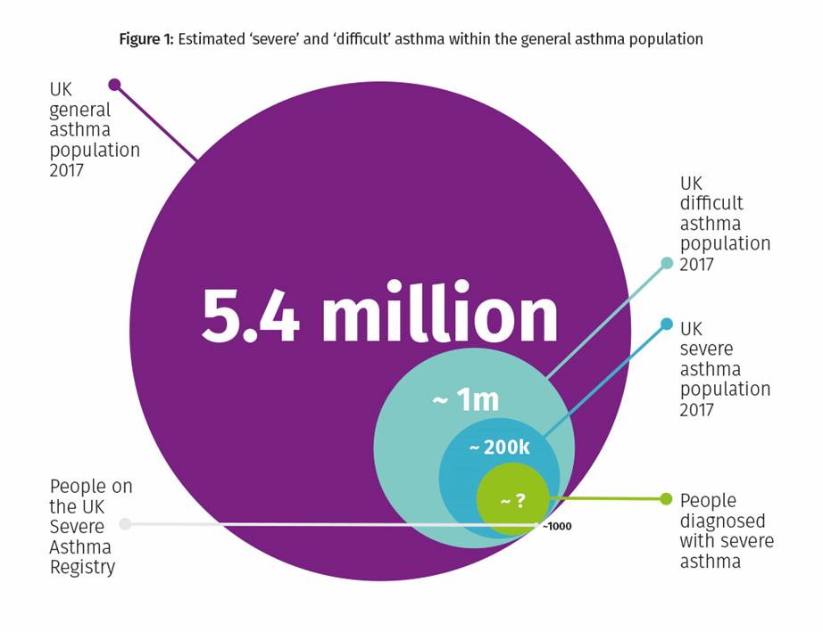
Severe asthma
Severe asthma affects nearly 5% of people with asthma (Hekking et al., 2015).
They suffer greater morbidity yet fall outside the evidence-base that informs most asthma care, requiring specialist attention, treatment and pathways (Wenzel., 2011)
The introduction of monoclonal antibodies such as Omalizumab and Reslizumab has offered hope to many.
Accurately identifying the subgroups within severe asthma that will respond well to the mAbs can be difficult.
Notes:
Hekking PP, Wener RR, Amelink M, et al. The prevalence of severe refractory asthma. Journal of allergy and clinical immunology. 2015;135:4
Wenzel S. Characteristics, definition and phenotypes of severe asthma. In: Chung KF, Bel E, Wenzel S, editors. ERS Monograph: Difficult-to-Treat Severe Asthma. 51: European Respiratory Society; 2011.

Slide 21
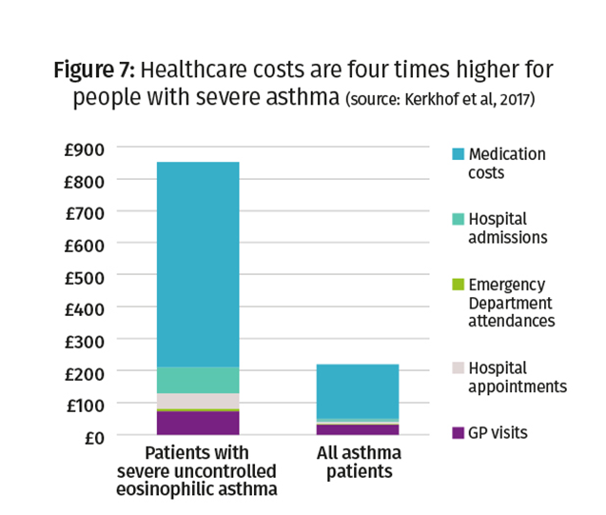
The importance to the NHS of Severe Asthma

Slide 22

Asthma UK recently launched report – July 2018

Slide 23
What did we do?
Continuing on from our past severe asthma work which focused on research for new treatments
Here we try to understand the issues with difficult and severe asthma care in the UK
Interviewed 17 difficult/severe asthma clinicians and nurses from across the UK
Surveyed 72 primary and secondary health care professionals

Slide 24
Our findings
Clinicians think that patients are not being referred to specialists services when they should be
Reasons to refer a patient vary from health care professional to health care professional
Siloed patient data can make providing consistent care difficult
Type of difficult and severe asthma care available varies between tertiary centres
The issue of not knowing the size of the patient population makes its difficult to predict demand for services

Slide 25
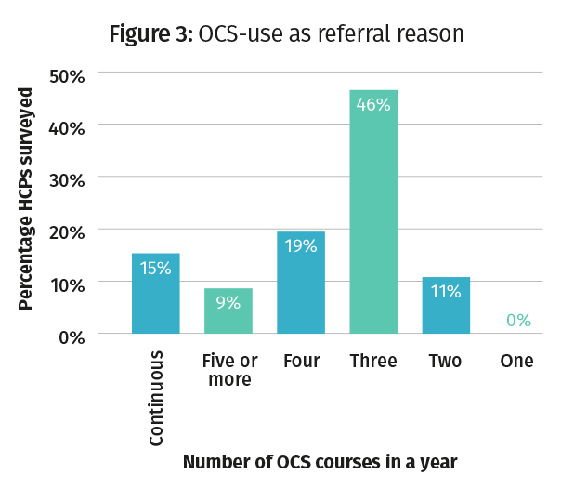
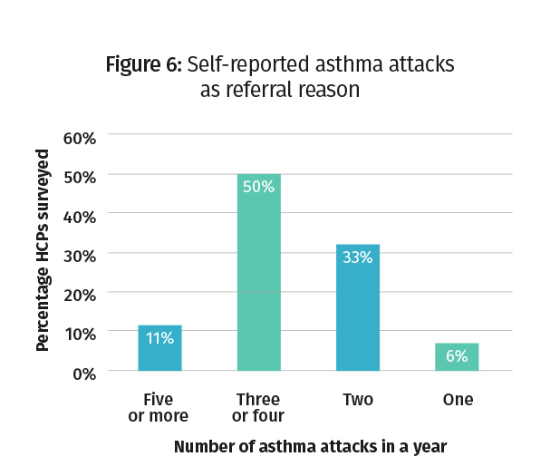
Variety in referral thresholds

Slide 26
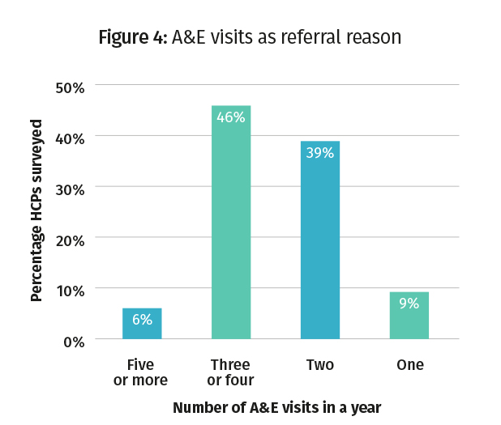
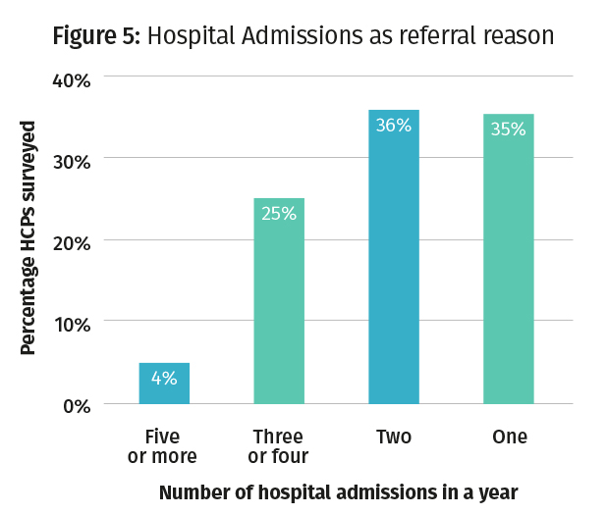
Variety in referral thresholds

Slide 27
Our recommendations (1)
Accurately determine the size of difficult and severe asthma populations for service planning
Agree clear, unambiguous definitions of the different types of difficult and severe
Develop and agree clear and unambiguous referral criteria between primary, secondary and tertiary care.
Improve standards across tertiary centres through the commissioning toolkit, peer review, and sufficient resources.
Develop, publish and promote new evidence-based strategies for the management of difficult and severe asthma.

Slide 28
Our recommendations (2)
Link and share patient care records across care settings and ensure that data is collected and used to improve service commissioning and delivery.
Through the development of the UK Severe Asthma Registry, gain a deeper understanding of the characteristics of the UK difficult/severe asthma population, to avoid unjustified variation, to aid service planning, delivery and the development of new treatments
Explore digital opportunities to support people with difficult/severe asthma and lessen pressure on services.

Slide 29


Slide 30
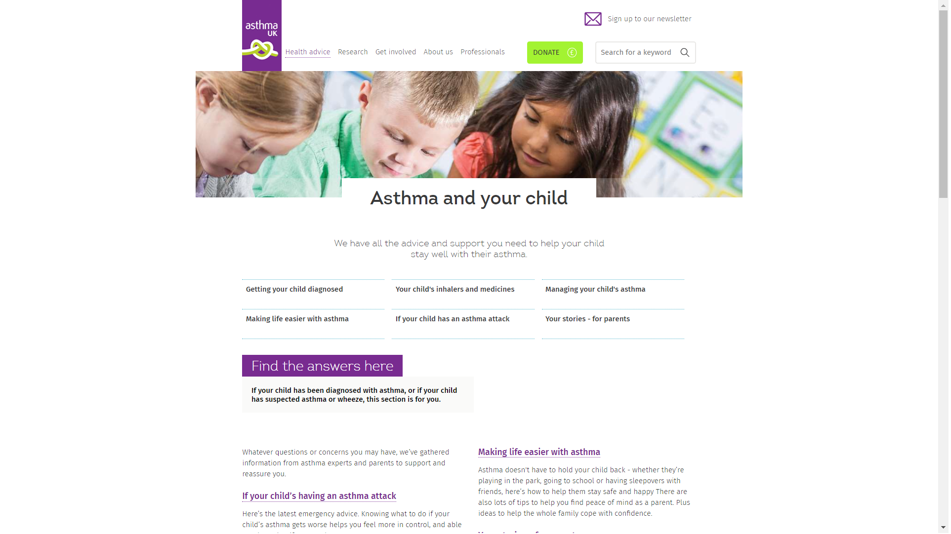

Slide 31
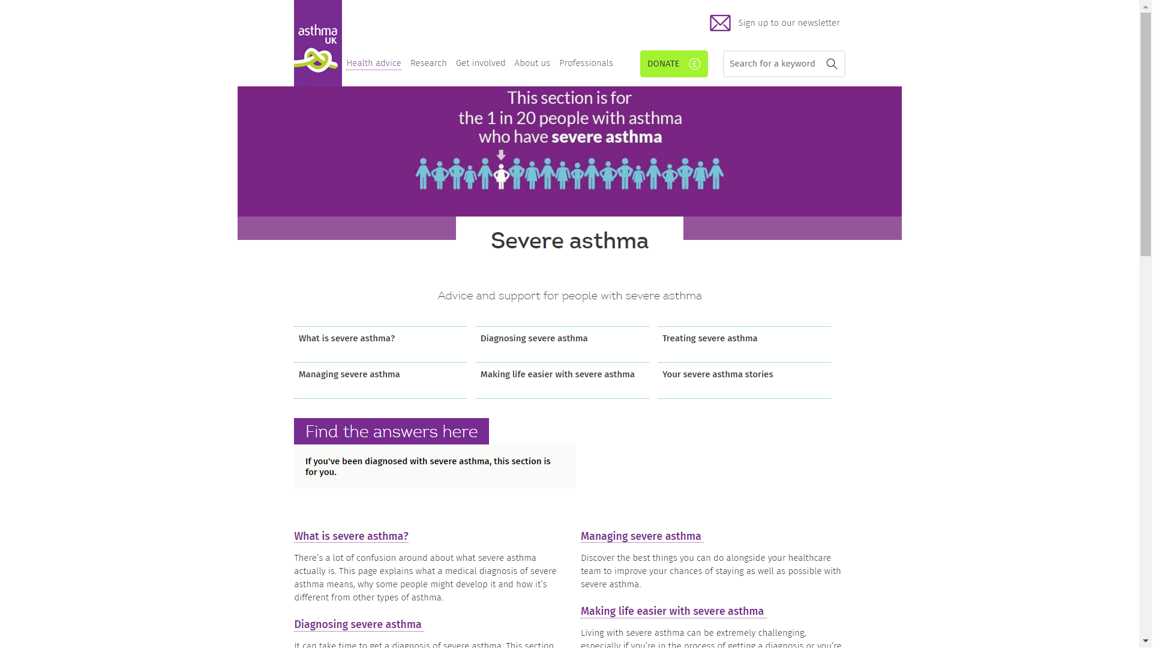

Slide 32
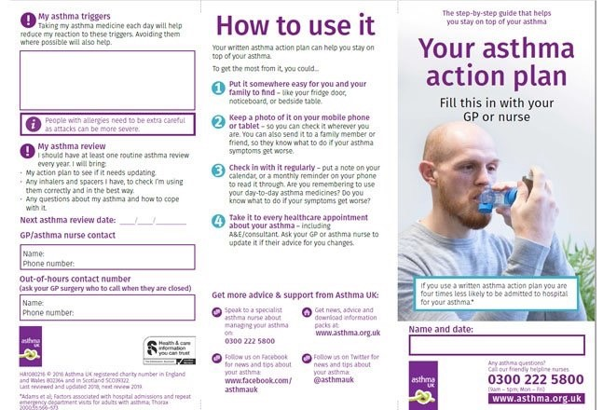

Slide 34
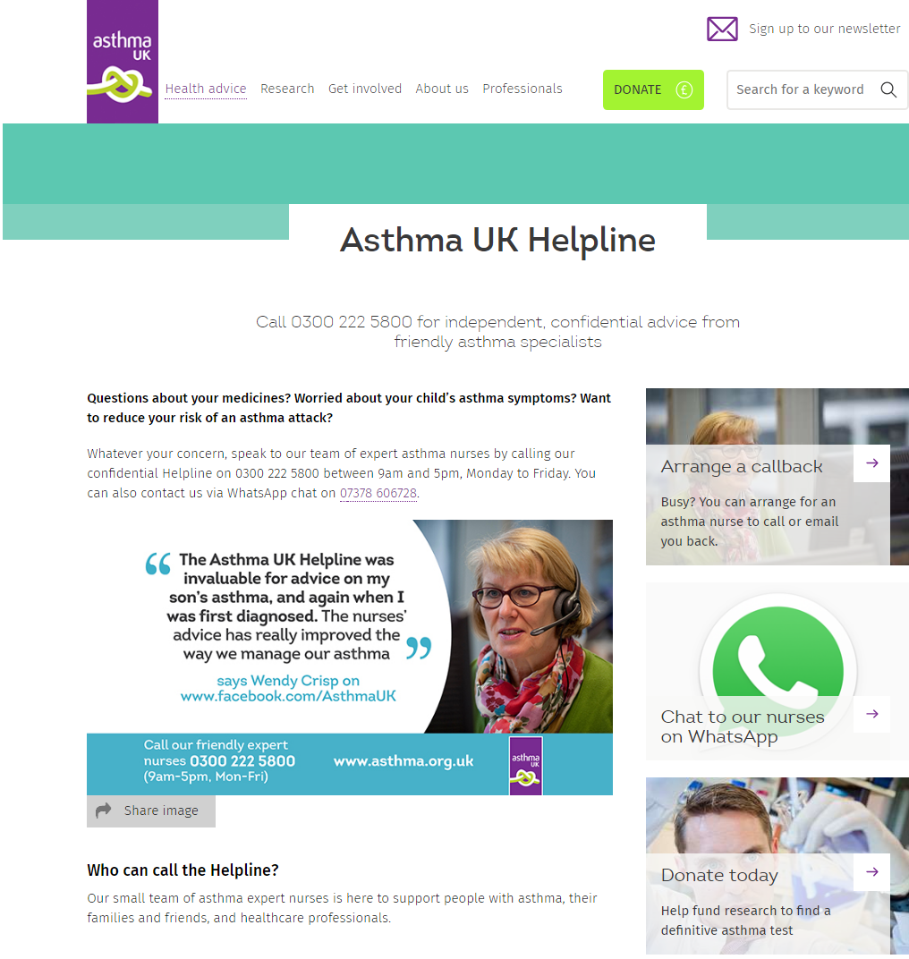

Slide 35
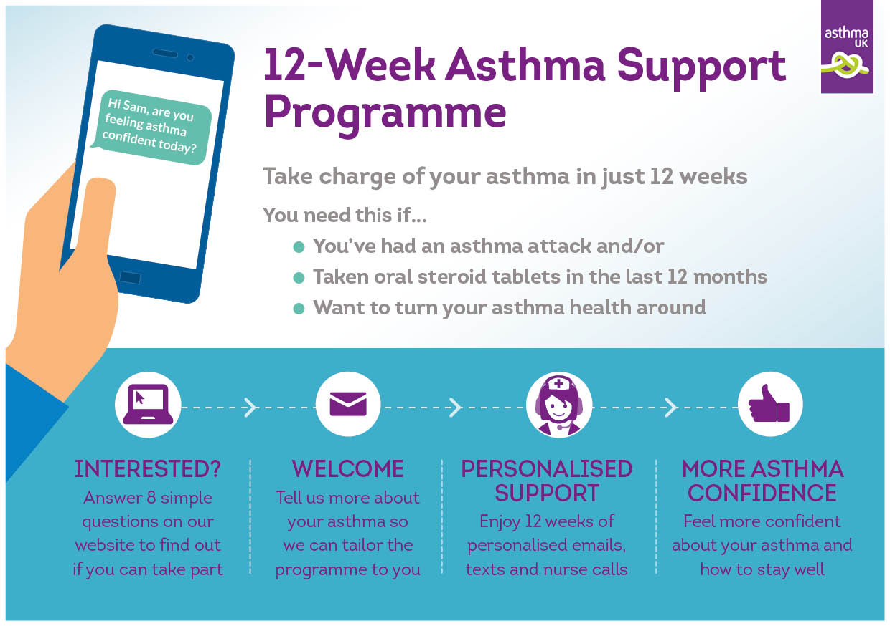

Slide 36
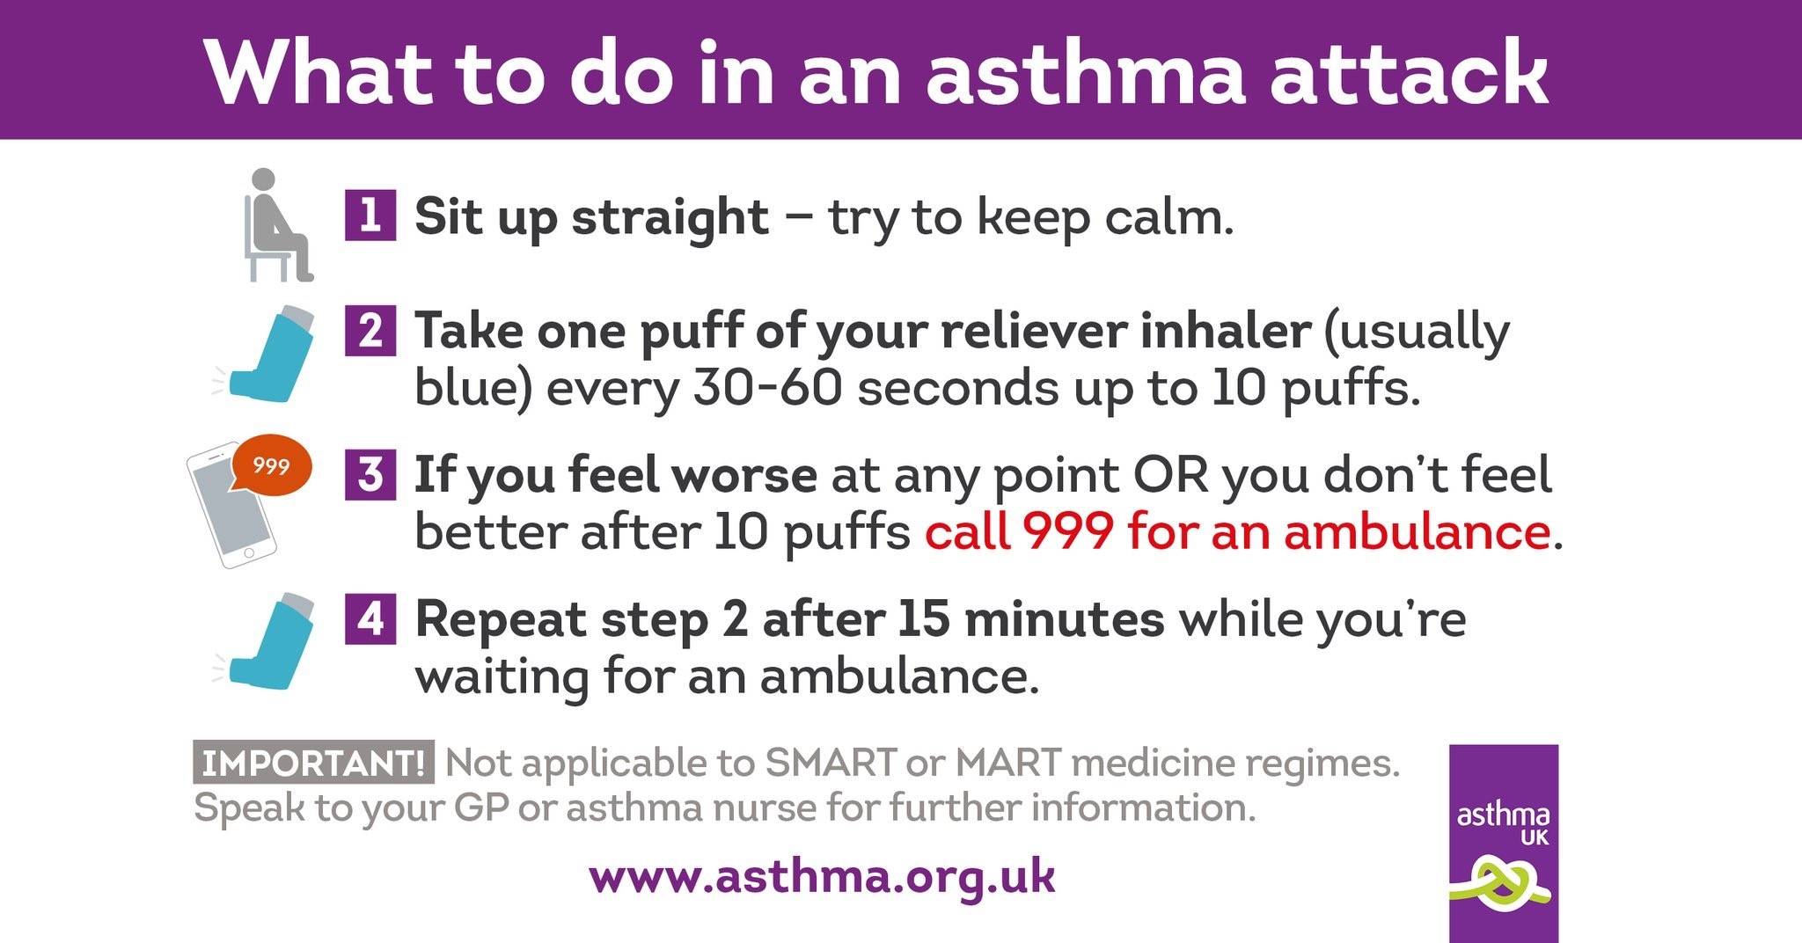

Slide 37
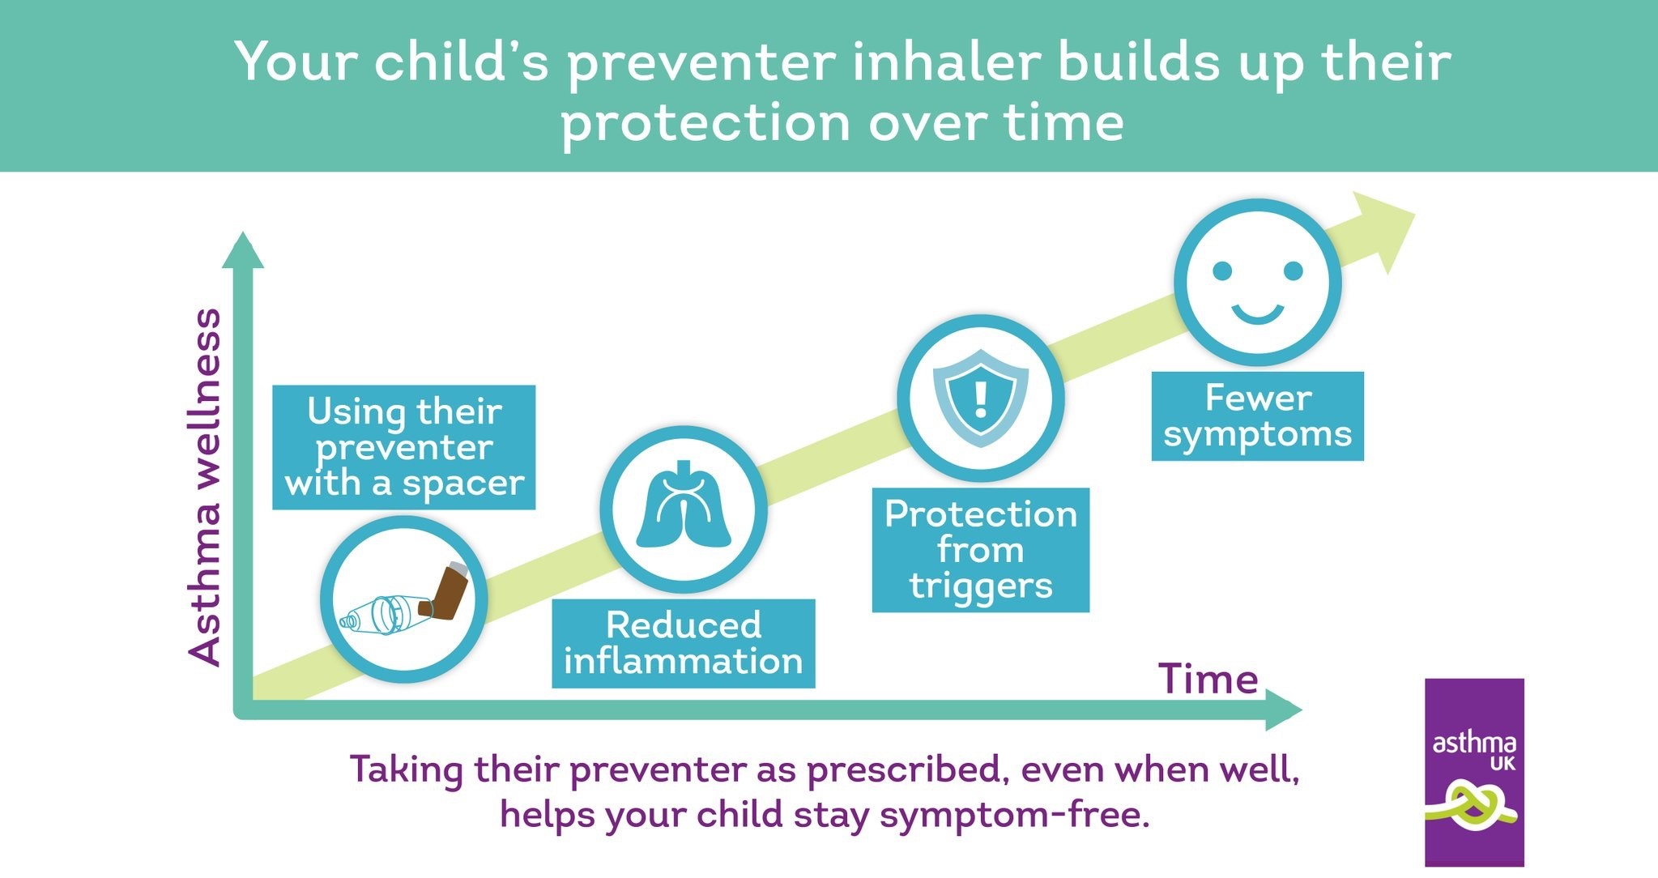

Slide 38
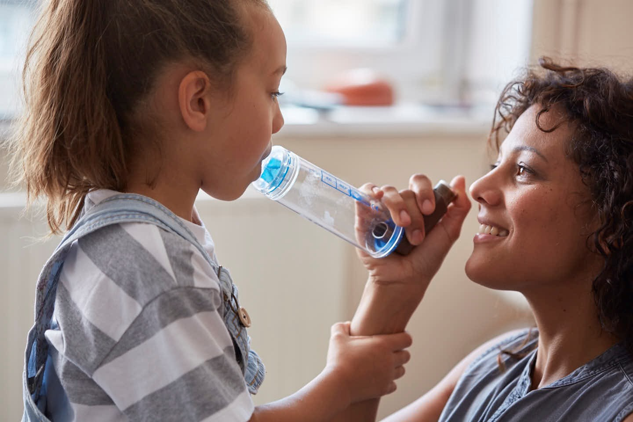
Coming very soon…. Inhaler videos

Slide 39

Thanks for listening…..

